Slide 1
eExperience
Status Report
Team TMYK
Jared Becher – Geoff Cooley – Justin Schulte

Slide 2
Sticking To The Schedule?
Sprint 2 Milestone: Finalize Requirements and get started on UI/Prototype
Initial collection of requirements gathered, need further discussion
Waiting to meet with client – Schedule conflicts all over
Set of initial, hand-drawn UI examples
Refined digital UI low-fidelity prototype
- Justin Schulte

Slide 3
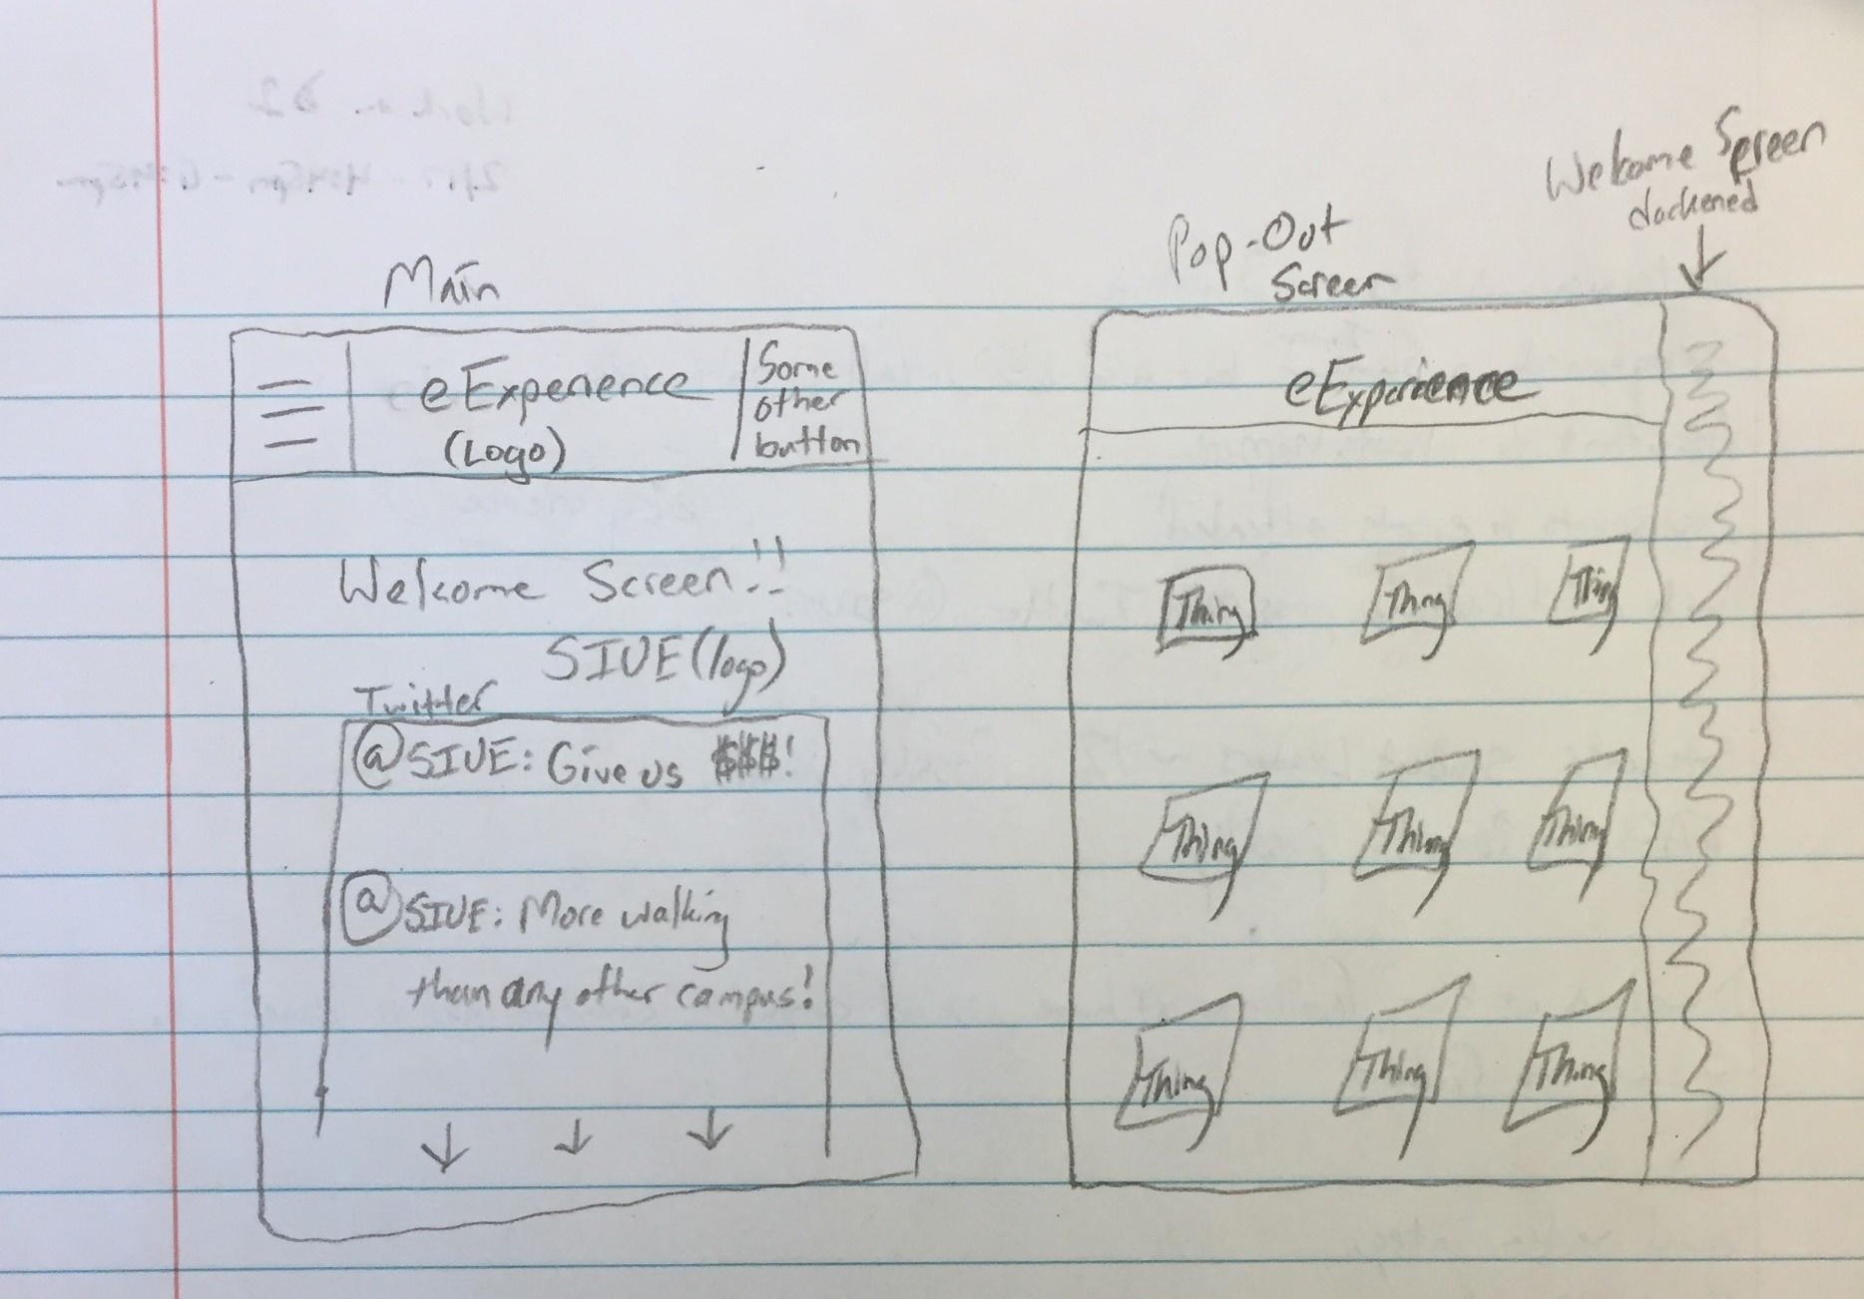
Early Hand-Drawn Design
Home screen features the official SIUE Twitter feed
Button at the top-left to activate a pop-out menu for app navigation
Some other button at the top-right
- Justin Schulte

Slide 4
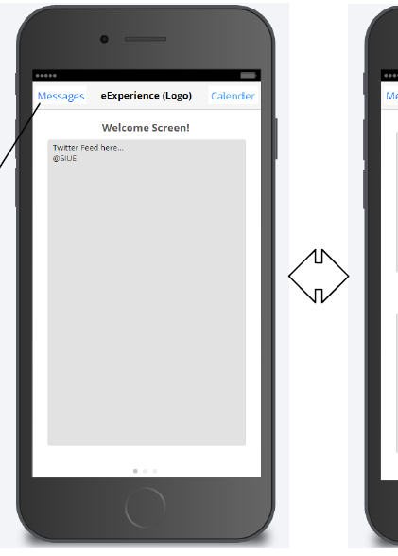
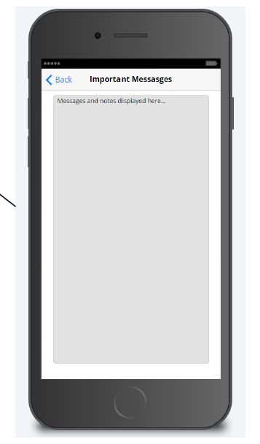
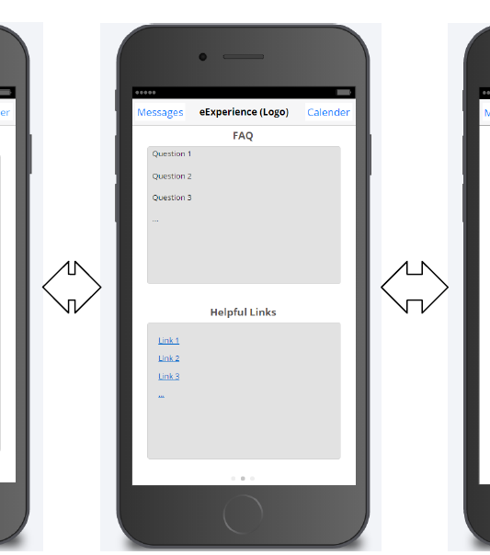
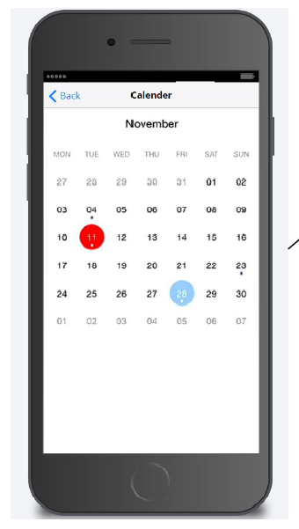
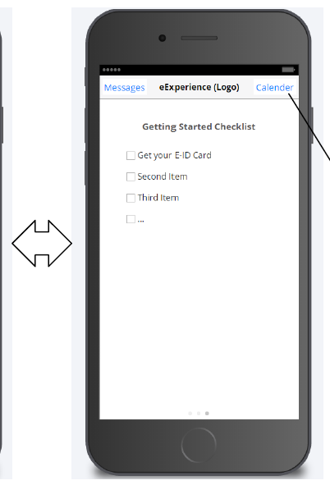
Digital Low-Fidelity Prototype
- Geoff Cooley

Slide 5
Anticipating Our Next Client Meeting…
Discuss the extent of functionality for:
An Inbox/Messages feature (without any sign-in process)
The Checklist feature (could we point to a web page instead?)
Also discuss necessity of Inbox/Message feature
Could remove in favor of utilizing Welcome message
Discuss the structure of event assessments
Multiple choice, short answer, etc.
But most importantly…
- Geoff Cooley

Slide 6
Our Next Meeting…
Discuss a possible integration with ITS and the existing SIUE app
Learn how that will affect our development efforts
Will we adopt a pre-existing layout or style?
Will we have server/database support already in place?
Will we have to change to a platform-specific development environment to conform/agree with the SIUE app? If so, which will we choose?
After this meeting, we should have more confidence in this project moving forward with a clearer path for development.
- Geoff Cooley

Slide 7
In The Meantime… Sprint 3 Begins!
Documentation:
Adopting several documents/processes from CS 325:
Use Case Descriptions & Actor-System Interaction Modeling
Use Case Scenarios
Sequence Diagrams (Maybe…)
Will also give us a clearer path moving forward with development/implementation
- Jared Becher

Slide 8
Questions?

